Slide 1
Career Location Compensation Analysis Tool
Steven Palmer
CS 2XB3
L04

Slide 2
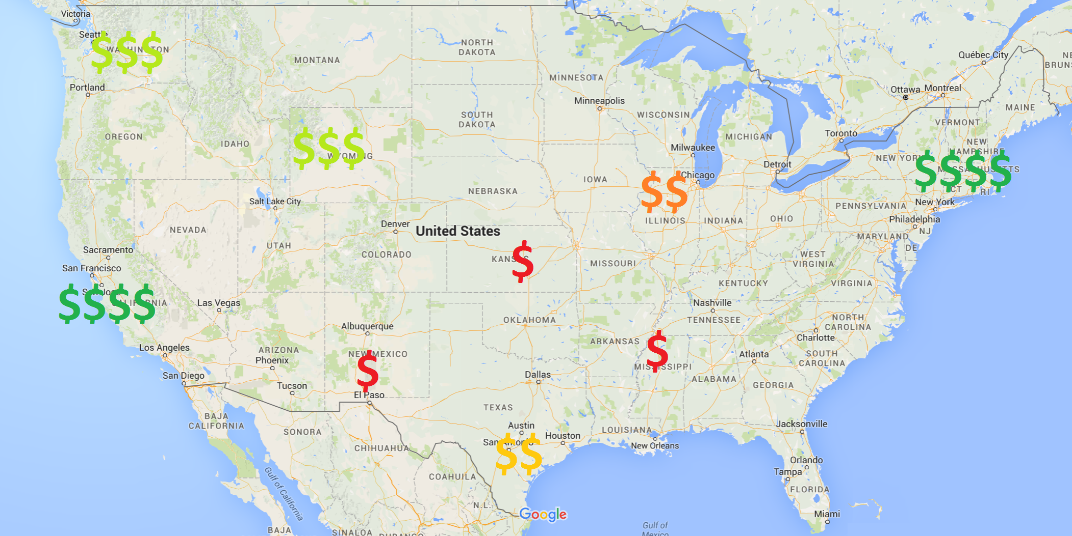
Problem
Compensation for a particular career can vary dramatically based on location

Slide 3
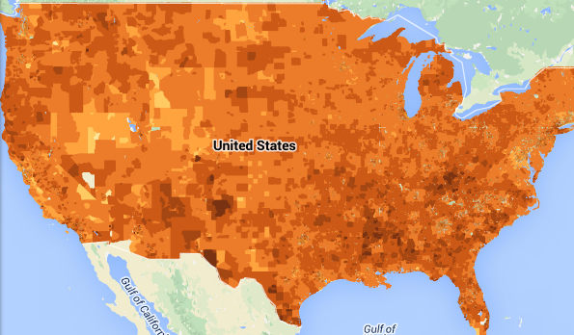
Problem
BUT: Cost of living also varies based on location!
Which locations are best from a financial point of view?

Slide 4
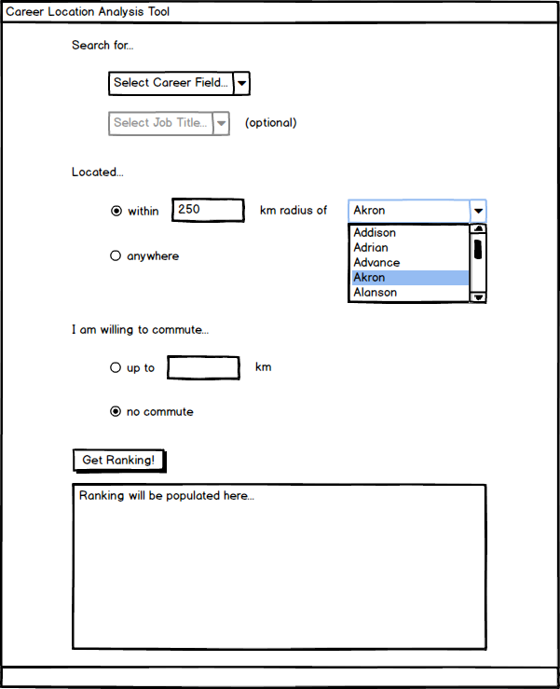
Solution: Analysis Tool
User Inputs:
Career field and job title
Location restriction
Commute distance
Software Outputs:
Listing of the top locations for a career based on cost of living adjusted compensation

Slide 5
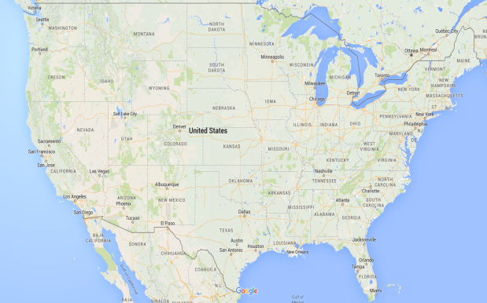

Data Analysis Backend
User Query
Output
Location Data
Affordability Data
Employment Data
Image sources: Google Maps, US Dept. Labor, US Dept. Housing/Transport

Slide 6
Career Location Compensation Analysis Tool
• This was an interesting project and if it was one of the projects in our team, I would have liked to implement it.
A. Strongly disagree
B. Disagree
C. Neither agree nor disagree
D. Agree
E. Strongly Agree

